Slide 1
Supporting doctors who undertake a low volume of clinical work: A practical workshop for Appraisers
Paula Wright Paula.wright1@nhs.net
GP, Appraiser, Tutor for HEE

Slide 2
Aims of workshop
Knowledge of the new framework for supporting doctors working low volumes
Skills in:
-eliciting appropriate professional context about mitigating factors
-making judgements about mitigation of risk factors against the framework
-developing PDP actions to mitigate against the risk factors

Slide 3
Outline
Framework
Small group discussion of cases
Plenary feedback frim groups- where next?

Slide 4
GP
Non Clinical roles:
Clinical other roles

Slide 5
How can we retain these doctors safely ?
WHO should decide ?
What can we learn from them ?
How much is enough?
Can we manage this problem better ?
HOW do we decide ?
Are there other factors which matter?

Slide 6
Fast automated
Slow effortful
Experience

Slide 7
Fast automated
Slow effortful
Reducing Volume

Slide 8
Overlap
Breadth of role
Integration benchmarking &peer support
Risk management
CPD
Duration& spread
Experience
Quantitative to Qualitative approach
Structured
Reflective Template
For QIA

Slide 9
GP working
< 40 sessions/year
Doctors and appraisers may seek advice from their AL/RO/team at any time
Routine appraisal and revalidation process
Low Vol SRT
Discuss at Appraisal
+- actions for PDP
SRT review by
RO (deputies or AL) :
Insight of doctor, Engagement with appraisal process
Sufficient mitigation?
Discussion
Dr +AL/RO/deputy
+/- LMC rep
Support/ advice
Withdrawal from Performer’s List
Continued practice, no changes
OR
Support (HEE, learning group, chambers, clinical networks, mentorship etc.)
Specific schemes for e.g. Retained doctor and career plus initiatives;

Slide 10
LOW VOLUME SRT: demonstrating mitigation of risk
Minimum overlap between roles. Inexperienced, longer period, long breaks. CPD dominated by other portfolio. Infrequent inclusion in workplace based meetings. Contact with the organisation only for complaints/SEs. Excluded from usual cascades. Frequent moves / poor induction Usually working in isolation. No on site peer contact. Relies primarily on immediate peer advice/supervision
Risk
Mitigation

Slide 11
LOW VOLUME SRT: demonstrating mitigation of risk
 |  | Significant overlap Experienced short duration no large breaks Robust CPD amount/ approach/ scope. Vicarious exposure via peer learning groups (face to face, online, social media) Keeping to a restricted scope Not returning to extended scope without clear plan. Induction and requesting feedback Formal benchmarking Individual data Informal benchmarking by inclusion in regular On site access to peer advice and support.
Risk
Mitigation

Slide 12
Outline of workshop: 1
Small group discussion of cases.
For each criteria is this doctor low/ medium / high risk ?
Up to 3 questions you might want ask the GP at the meeting where there is insufficient information to help you make this judgement about risk.
What action[s] do you think the appraisee might want to consider for their PDP arising from their work situation?
Does the scenario raise any questions you would like to clarify with the RO or the appraisal team?

Slide 13
Outline of workshop 2
Plenary:
Groups feedback key points about each case
Key points about the useability of the tool
Suggestions for implementation/further work (GP/Hosp)

Slide 14
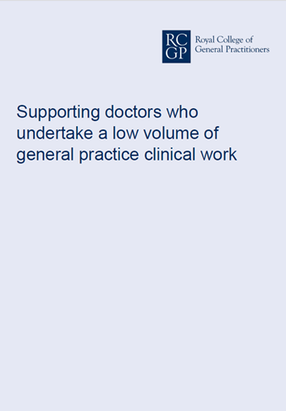
Facilitate Reflection and insight by the GP
Help them demonstrate they are safe and mitigating risks
Improve the potential for early support for the doctors from the appraiser, and the RO (and their team)
Doctors retains their skills and flourishes
Doctor retained safely in the workforce

Slide 15
Where to find guidance
https://www.bma.org.uk/connecting-doctors/the_practice/b/weblog/posts/new-revalidation-guidance-clarity-for-gps
https://www.bma.org.uk/connecting-doctors/the_practice/b/weblog/posts/when-you-work-fewer-than-40-sessions-a-year-of-uk-general-practice-new-guidance-to-support-gps-appraisers-and-ros
http://www.rcgp.org.uk/-/media/Files/Revalidation-and-CPD/2018/RCGP-LVCW-framework-aug-2018.ashx?la=en

Slide 16
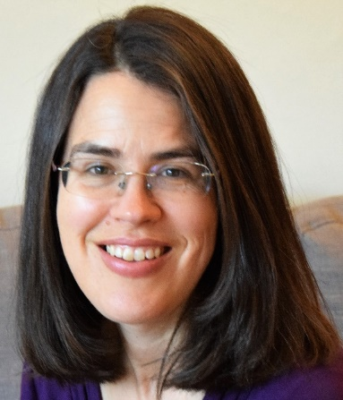
Feedback to Paula Wright Paula.wright1@nhs.net; @pfw69
October 2018
GP, Appraiser, GP tutor HEE,

