Slide 1


Knowing me Knowing you- Cultural competence in Appraisals
Professor Nitin Gambhir
Lead Dean Director
NHS Education for Scotland

Slide 2
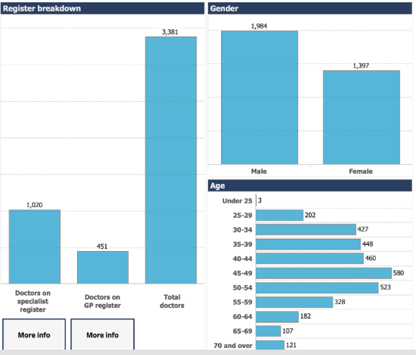
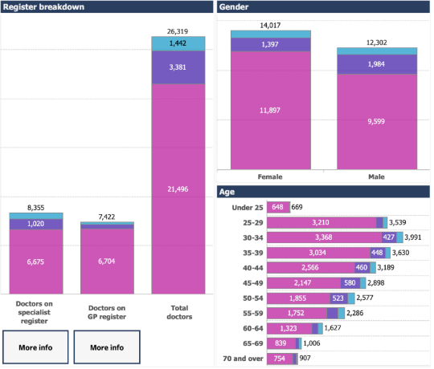
Notes:
Since its inception in 1948, the NHS has relied heavily on the contribution of overseas doctors in the successful running of its services. The number of medical schools in the UK has increased but medicine, its science and practice, has also expanded.¹Therefore, the NHS will continue to depend on doctors from overseas to fill the gap

Slide 3

Cultural Competence and Appraisals
The ability to understand, appreciate and interact with people from cultures or belief systems different from one's own
Willingness to examine own positive and negative assumptions
Honest reflection on cultural ignorance, stereotypes and prejudices
Lifelong journey- self-evaluation and self-critique
Notes:
Cultural competence is the ability to understand, communicate with and effectively interact with people across cultures. Being Culturally competent is more than just being culturally aware or being tolerant to another culture. It is the ability to challenge ones own cultural assumptions values and beliefs. Cultural competence is not static, it is a never ending journey of critical reflection with an ultimate aim of maintaining equality, diversity and fairness to all. Cultural Safety

Slide 4
Why is Cultural Competence important?
Reduces stereotyping, bias and discrimination
Improves Cultural and Psychological Safety

Slide 5
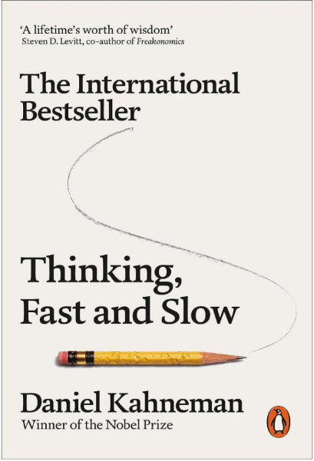
"Biases are the stories we make up about people before we learn who they are"
Notes:
unconscious biases and blind spots- "Our brains are highly habitual. Our brains start reaching conclusions without immediately telling us that it's doing so. Myers said. They are especially apparent "when things are high-risk, or you have to make quick decisions.”
More than 5 million people have taken Harvard's Implicit Association Test (IAT), at www.implicit.harvard.edu/implicit/demo, which aims to help people identify their unconscious biases. Among those who have taken the test:
-- 80 percent of people prefer younger people over older ones.
-- 75 percent of the people prefer white people over minorities.
-- 45 percent of the black people taking the test also favour white people over people of colour.

Slide 6
PSYCHOLOGICAL SAFETY
It’s a shared belief held by members of a team that others on the team will not embarrass, reject, or punish you for speaking up, asking questions, expressing concerns or making mistakes
When you have psychological safety in the workplace, people feel comfortable being themselves. Productivity and motivation improves
Notes:
Code-named Project Aristotle - a tribute to Aristotle’s quote, "the whole is greater than the sum of its parts" (as the Google researchers believed employees can do more working together than alone) - the goal was to answer the question: “What makes a team effective at Google?” hundreds of teams were analysed by psychologists to see why some teams work better than others and they found it is not the who in the team but psychological safety that mattered the most and led to productive teams.

Slide 7
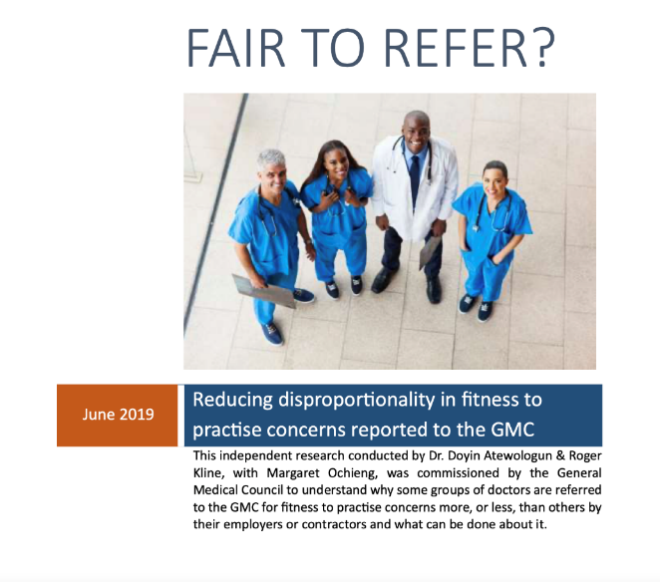

Slide 8
Non-UK doctors have 2.5 times higher rate of being referred by an employer compared to UK graduate doctors
BAME, older male, IMG and non-specialists
Micro (individual) and Macro (institutional/structural) factors
Perceptions and Bias
Insider- Outsider dynamic in the NHS
Lack of confidence in raising concerns
Inverse educational law
Notes:
If you’re an ethnic minority doctor working in the NHS you’re twice as likely as a white doctor to be referred by your employer to the General Medical Council (GMC). If you trained outside the UK that figure rises to two and a half times as likely. Roger Kline, research fellow at Middlesex University Business School and coauthor of Fair to Refer?,a 2019 report1 commissioned by the GMC that sought to understand why certain groups of doctors more often fell foul of complaints about their fitness to practise.

Slide 9
Disproportionality
42% doctors on the GMC register are IMGs
MPTS sanctions 44% EM Vs 36% White
Struck off the GMC register 37% EM Vs 26% White
In contrast, referral rates of ethnic minority and white doctors by the public were roughly the same

Slide 10
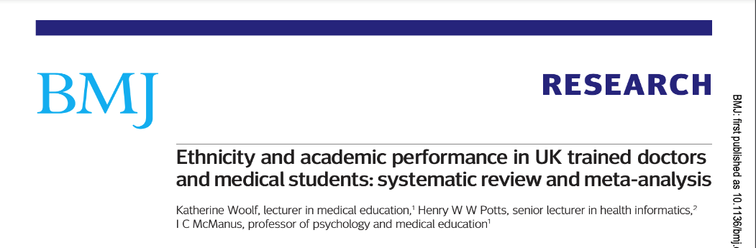
n=23742
UK trained doctors and medical students from minority ethnic groups tend to underperform academically compared with their white counterparts
Negative effects of non-white ethnicity on performance were significant with an odds ratio of failure of 2.5 times that of white ethnicity

Slide 11
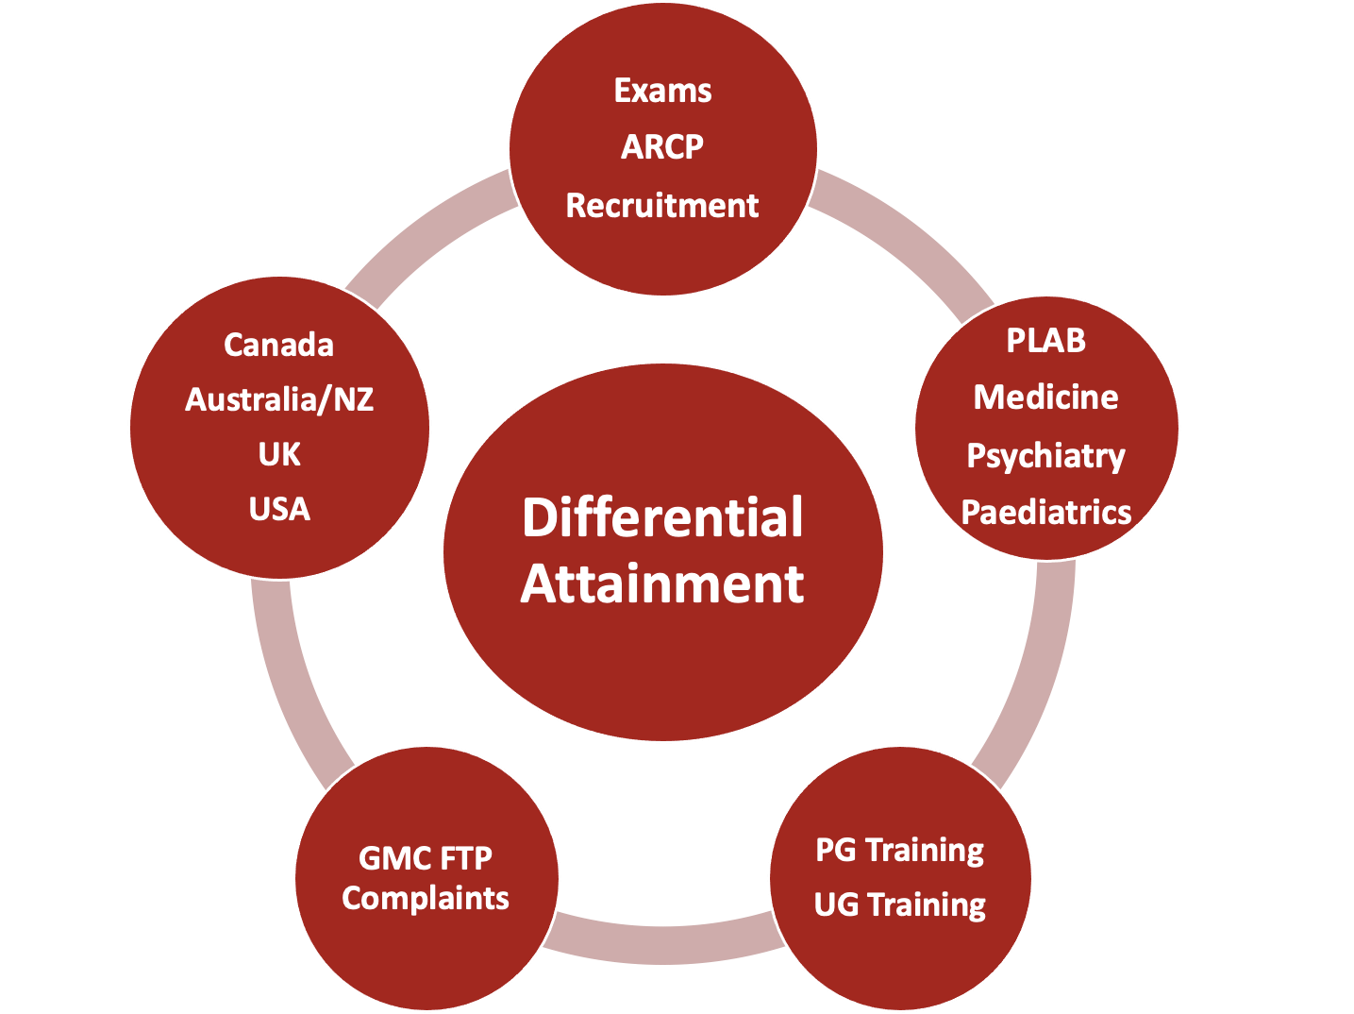

Slide 12
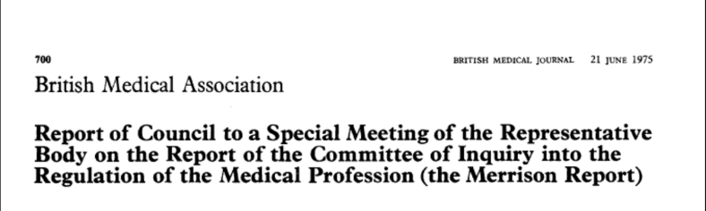
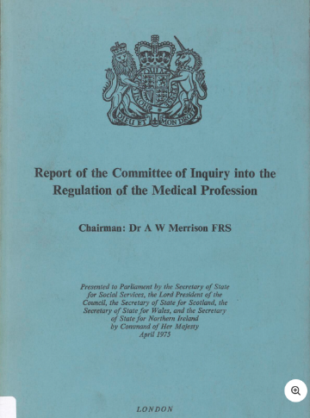
It would be surprising if doctors from overseas did not lack knowledge of the operation of the NHS, did not find difficulty in understanding the significance of the euphemisms and colloquialisms which for many patients are their most accurate means of expression, and even more surprising if they could easily come to grips with the variety of dialects they may encounter

Slide 13
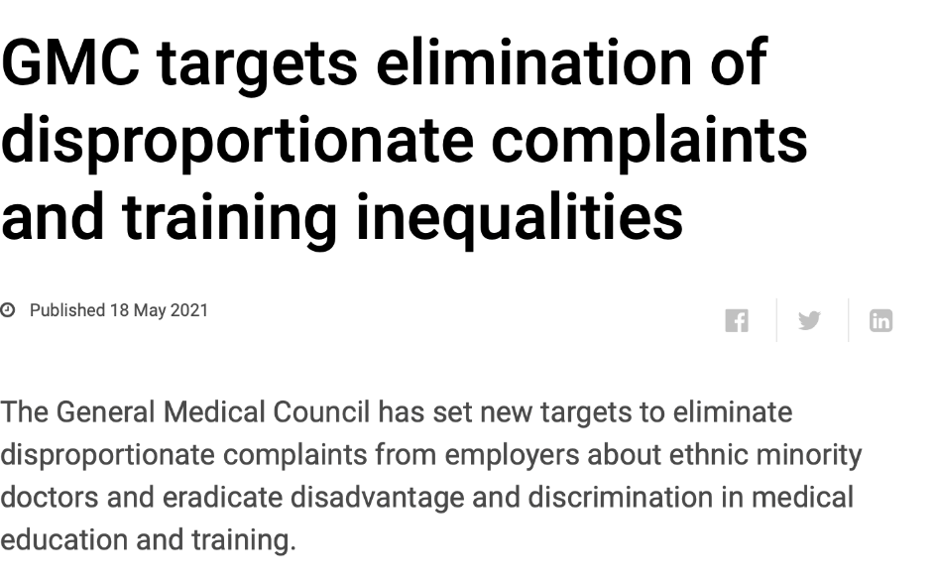
Notes:
The targets, to be met by 2026 and 2031 respectively, focus on areas where clear evidence of disproportionality has been seen over time

Slide 14





Over three quarters (76%) of respondents experienced racism in their workplace on at least one occasion in the last two years.
Ethnic minorities experience institutional barriers to career progression despite making up 41.9% of the medical workforce
Doctors are experiencing racial discrimination from colleagues and patients, and this is significantly under-reported due to perceptions of negative repercussions.
This issue is causing a growing mental health burden on ethnic minority doctors.

Slide 15
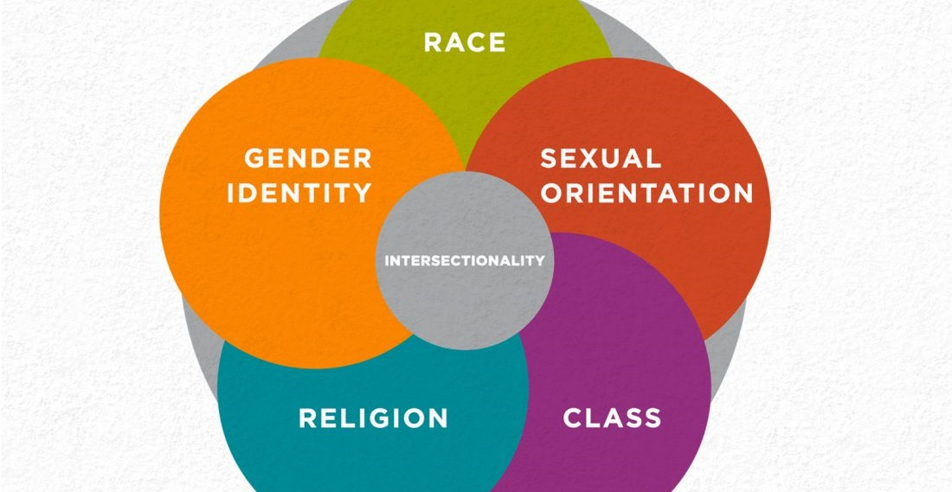
Notes:
the interconnected nature of social categorizations such as race, class, and gender as they apply to a given individual or group, regarded as creating overlapping and interdependent systems of discrimination or disadvantage
As late as the 1970’s Kimberle Crenshaw a black woman filed a case against General Motors for race and gender discrimination and the case was lost because it was not permissible to consider 2 forms of discrimination at the same time as per law.

Slide 16
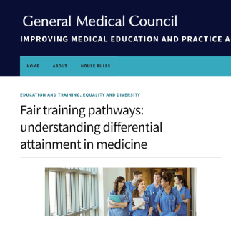
Challenges
Culture Shock and Ethnic Homophile
Perceived Bias and stereotype threat
Lack of Psychological Safety (fear of being labelled problematic)
Communication Challenges
NHS/Work Culture
Work Life Balance, Isolation
Education, Learning and Assessments
Notes:
Isolation and loneliness were common, and interactions between UK staff who were largely perceived as indifferent or even hostile, and IMGs are limited to work-related communications.’

Slide 17
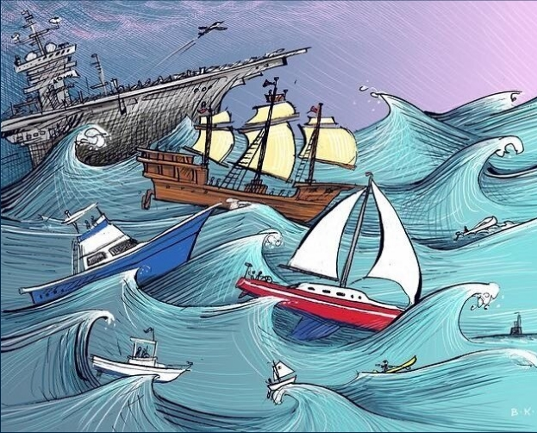

WE ARE NOT ALL IN THE SAME BOAT.
WE ARE ALL IN THE SAME STORM.
SOME ARE ON SUPER-YACHTS.
SOME HAVE JUST THE ONE OAR.
Illustration by Barbara Kelley
This Photo by Unknown Author is licensed under CC BY

Slide 18
Knowledge Skills and Performance
Keeping Up to Date- CPD and PDP
Reflective practice
You must have the necessary knowledge of the English language to provide a good standard of practice and care in the UK
Notes:
Includes recording work clearly accurately and legibly- electronic patient records

Slide 19
'I was simple enough to think that the British people were all the same, all speaking the same sort of language, the language which I learnt at English school in India. I was surprised I couldn't understand the English nurse and was even more surprised because she did not understand English - my English!'
Fair Training Pathways
Notes:
The General Medical Council (GMC) report neatly summarises the issues as ranged from ‘difficulties with subtleties of language and dialect to misunderstandings of the nuances of non-verbal communication and social and behavioural norms’

Slide 20
LANGUAGE IS MORE THAN JUST WORDS
When people from different cultural backgrounds communicate, even in a shared language, the intent behind the message may be very different from the effect it creates.

Slide 21
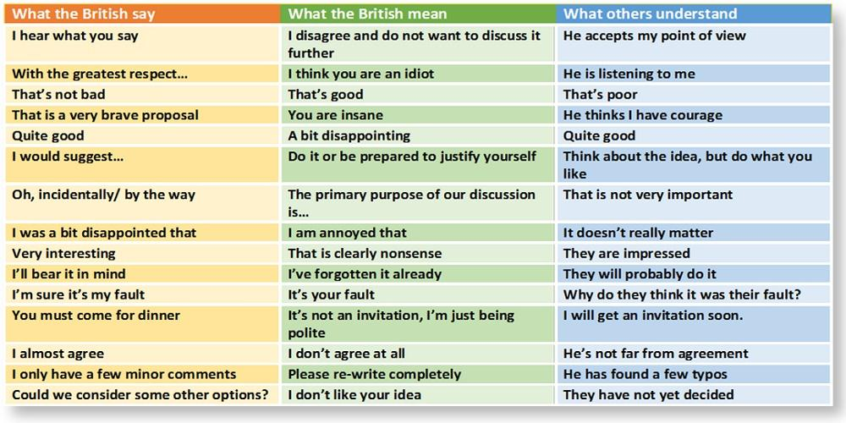

Slide 22

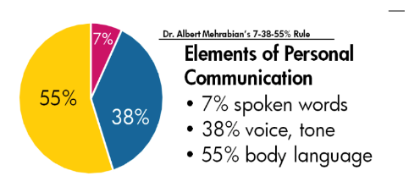
SYMBOLS (non-verbal communication)
Notes:
Yet more complexities arise when non-verbal gestures matter, such as eye contact, facial expression or body language, which hold cultural clues which may be misinterpreted.²¹ A particular difficulty is when discussing sensitive issues such as a sexual history, and problems of a different sort when breaking bad news

Slide 23
Communication
Language and communication difficulties will make misunderstandings and errors more likely
academic achievement in English does not in itself predict communicative competence in professional practice
subtle features of language can impact on professional and social relationships, as well as perceptions of competence
Accents, colloquialisms and metaphors
Formal vs conversational English

Slide 24
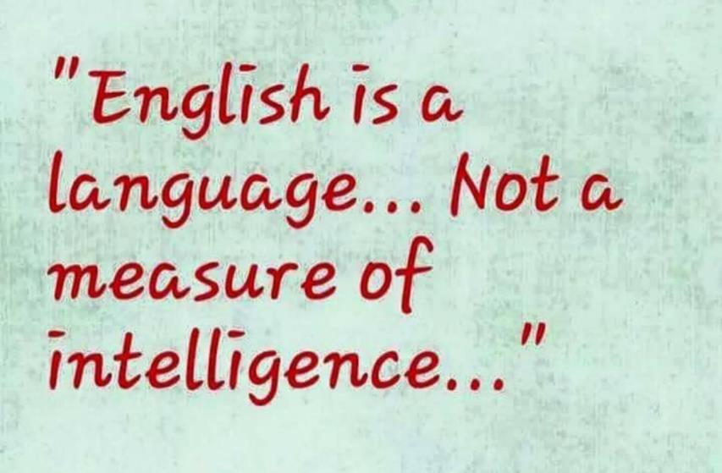

Slide 25
Reflection
Reflection is assumed to be a new concept for many international graduates, with most describing their previous education as ‘science-orientated’.
IMGs have been shown to favour didactic, teacher-focused educational techniques.
E-portfolio: Aspects of learning and teaching, such as learner autonomy, reflective practice
Learning styles and assessments
Notes:
theoretical and prescriptive approach to teaching and learning,
trainee-supervisor relationship, such as learner-centred teaching, group dynamics during teaching sessions, asking questions and accepting feedback

Slide 26
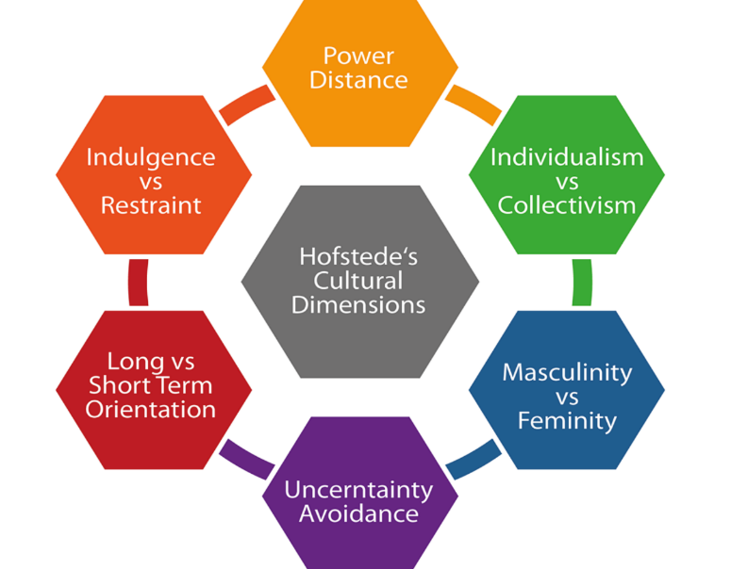
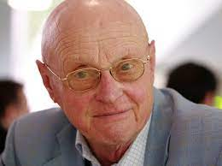
Cultural Dimensions

Slide 27
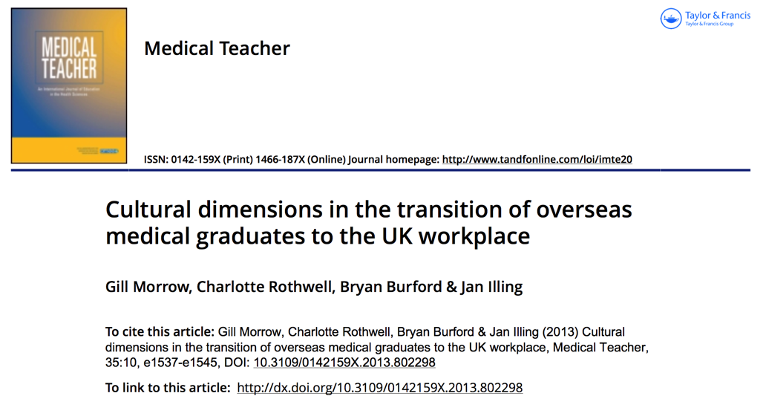

Slide 28
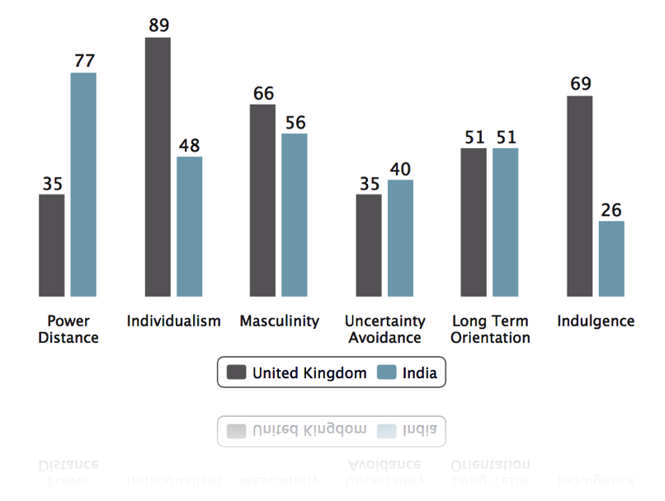
Power Distance: Relates to the unequal distribution of power in a society and the degree to which less powerful members accept this.

Slide 29
Power Distance
“In most Asian countries, doctors are seen as a higher level compared to the nurses’’ (Iraq)
‘
‘It was quite difficult for me . . . where we come from the consultants are usually assertive and authoritative and you can’t speak to them really . .’’ (Pakistan)
“In my country we don’t give patients too much choice, we decide everything for them. Here the patients are deciding everything’’ (Syria)
“Patient- centred approach feels to me like a Doctor-absent approach” (India)

Slide 30
Clinicians are the experts!
Authoritarian Doctor Centred short Consultations
Less patient choice.
Informed Consent a weak concept.
Students respect teachers (gurus). Junior doctors are terrified of seniors. Less likely to express opinions and disagreements.
Mistakes by doctors may be tolerated
Notes:
Recognising and admitting a mistake, thereby learning from it, is now becoming much more conventional in the NHS. The professional duty of candour published by the GMC and Nursing and Midwifery Council advocates an open and transparent environment and encourages healthcare professionals to be honest when mistakes happen.⁴⁰ Availability of similar guidance may vary across countries and therefore some overseas doctors may be unfamiliar with the actions they should take if mistakes occur

Slide 31
Culture is not an excuse for performance issues but may put them into perspective

Slide 32
Safety and Quality
Quality Improvement Activity – Audits
Significant Events
Health
Notes:
Systems to protect patients. Risks posed by own health concerns – Fitness to practice and reporting concerns about self and others. Prescribing safety and conflicts of interest.

Slide 33
Communication Partnership and Teamwork
Relationship with Colleagues
Relationship with Patients
Notes:
Working effectively within teams, now an almost universal practice, is more complex than it at first appears. Decisions are best made when all necessary information is available, which in turn is possible only when the consultant invites even the most junior members to contribute. Such subtleties may not be apparent to an overseas doctor if they have previously worked in a more rigid, hierarchical ‘top-down’ structure, where the most junior speaks ‘only when spoken to’, otherwise remains silent which, in the UK context, may be perceived as being a poor team playerCommunicate effectively, work collaboratively with colleagues, establish and maintain partnerships with patients.

Slide 34
Maintaining Trust
Complaints
Ethics, Probity, Confidentiality
Notes:
Mental capacity, end-of-life decisions, confidentiality and consent are some of the many issues encountered,^{21,25,28,35,36} complex as they are interwoven with morality, culture, and perception. These are encountered by health professionals worldwide but their resolution varies from country to country, guided by local culture and law. In the UK, decisions are shaped by the ethical and professional frameworks set out by the GMC.²¹ In such grey areas it is understandable why overseas doctors have experienced difficulties, which sometimes have led to unsatisfactory outcomes.^{21,37,38} Sharing clinical information with a patient and family and taking consent may vary between countries and cultures, shaped by laws and need to be addressed early in a doctor's career.³⁹Acting with honesty and integrity, consent, risks, capacity, safeguarding, disclosures, legal framework. Role of defence organization, gmc, lmc etc
Cultural background has a major influence on how an individual perceives professionalism

Slide 35

Knowing You Knowing Me
Social
Cultural background values and upbringing
Language and Communication
Medical
Medical school training
Specialty experience
Learning
Learning styles
Reflection and portfolio
Home and Family- Culture Shock
Patient interaction
Assessments and exams

Slide 36

ASSET VS DEFICIT- Appreciative enquiry
Different Health Care System
Diverse clinical presentations
Lack of resources
Experience of specialties
Diversity of thought and experiences
Motivation and Resilience

Slide 37

Plenty of high performing IMG doctors
Plenty of poor performing UKG doctors

Slide 38


Slide 39
SMALL GROUPS
Appraisal experiences – IMG colleagues
Communication (MSF and PSQ)
Learning, PDP and Reflection
Professionalism and Probity

