Slide 1
Patient Feedback
- a collaborative and digital approach
Dr Mimi Cogliano, Deputy GP Appraisal Lead (NHS Lothian & Borders)
Mr Paul Schofield Head of Digital Innovation, NHS Lothian
Dr Una Graham Chief of Medicine for MHS, Appraisal Lead for GG&C
Dr Andrew Harvey Consultant Anaesthetist, Glasgow Royal Infirmary

Slide 2
Introduction
What we are going to talk about:
Why they are needed
How they happened
What they look like
Summary

Slide 3
Why do we need this?
Examples:
GP: admin burden, what do locums do, how to capture “whole” practice?
OOH: no individual patient lists, who to give out/collate forms?
SC: difficulty getting done, small numbers, admin help? OPD?
Presentation of a “stack of paper forms”….

Slide 4
The “Lothian PSQ”
Collaboration between the Appraisal leads and Digital Innovation
Took ~ 1 year to complete; just launching now
RO support and a lot of good will
Over to Paul Schofield, Head of NHS Lothian Digital Innovation

Slide 5
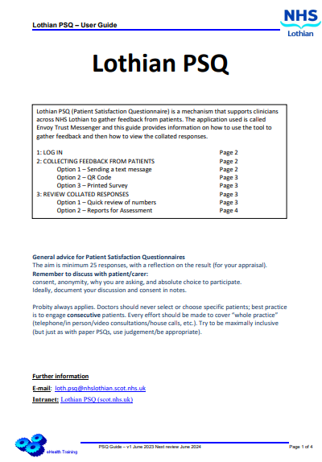
The “Lothian PSQ”
Digital Department involvement
Process
Information Governance - 'Privacy by design'
System Administration – Support
Create a process
User Guides, Videos etc
Integration
What can we share?

Slide 6
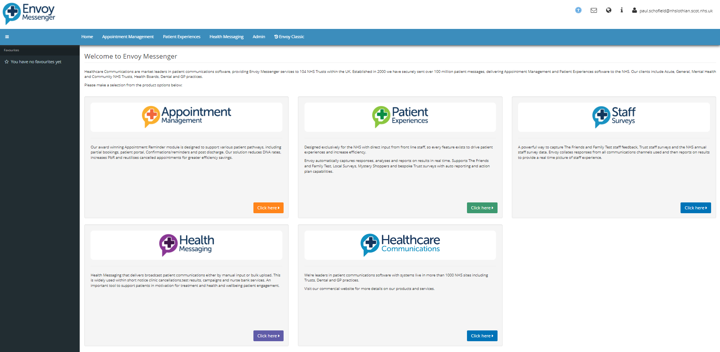
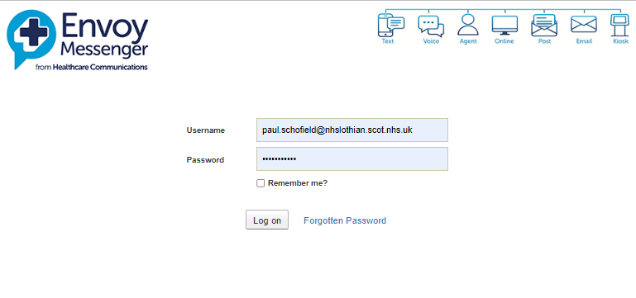
The “Lothian PSQ” - Envoy Trust Messenger

Slide 7
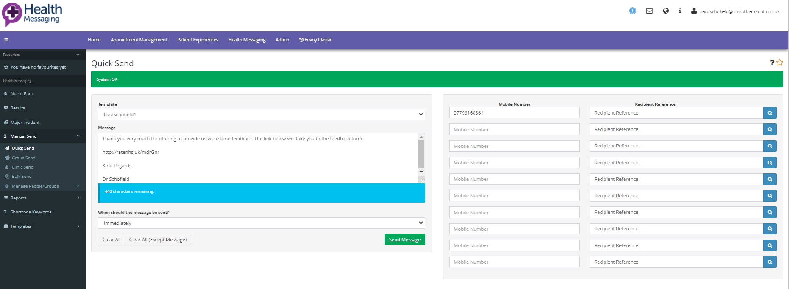
The “Lothian PSQ” - Envoy Trust Messenger

Slide 8
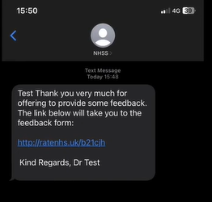
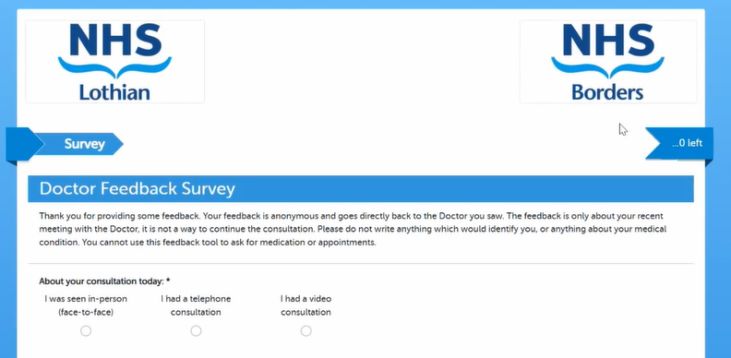
The “Lothian PSQ” - Envoy Trust Messenger

Slide 9
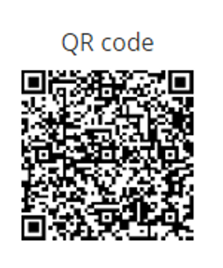
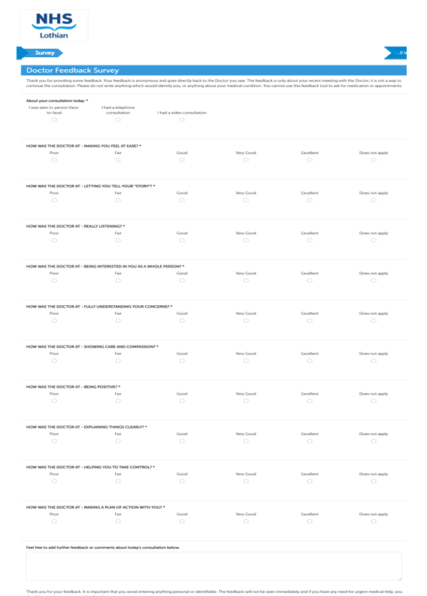
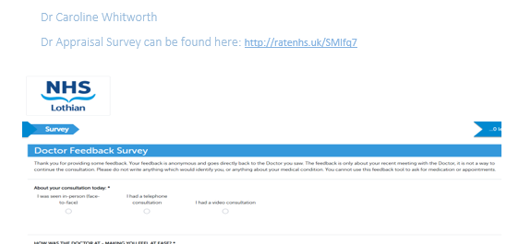
The “Lothian PSQ” - Envoy Trust Messenger

Slide 10
The “Lothian PSQ” - Envoy Trust Messenger

Slide 11
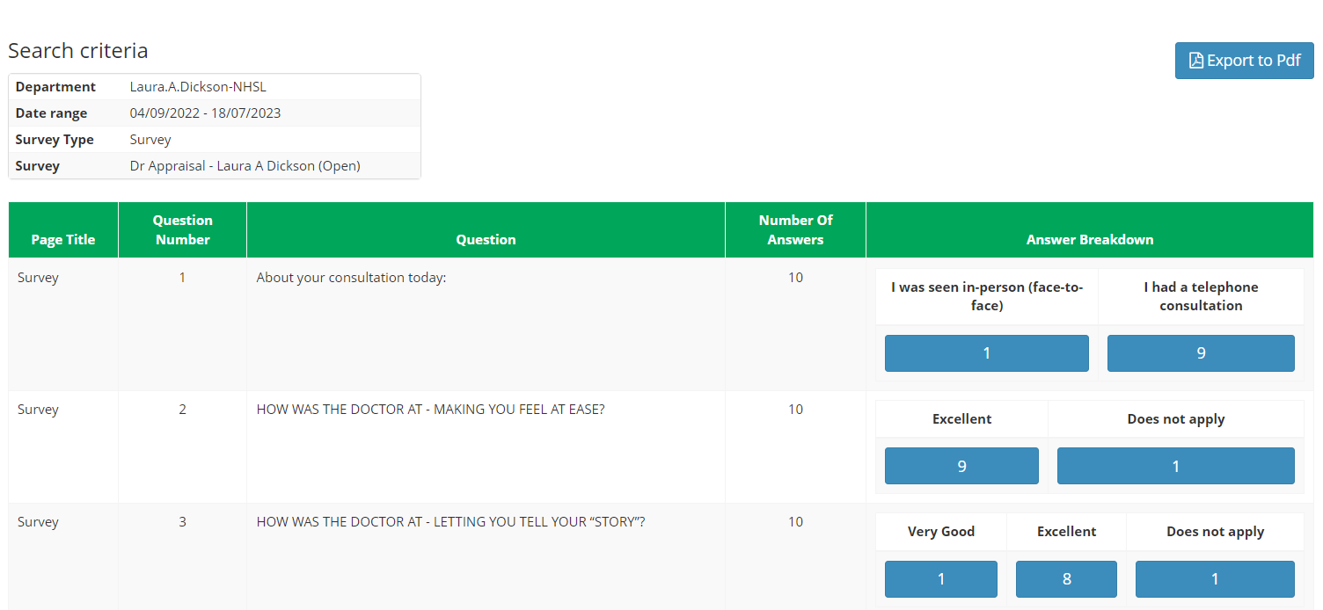
The “Lothian PSQ” - Envoy Trust Messenger

Slide 12
The “Lothian PSQ” - Envoy Trust Messenger

Slide 13
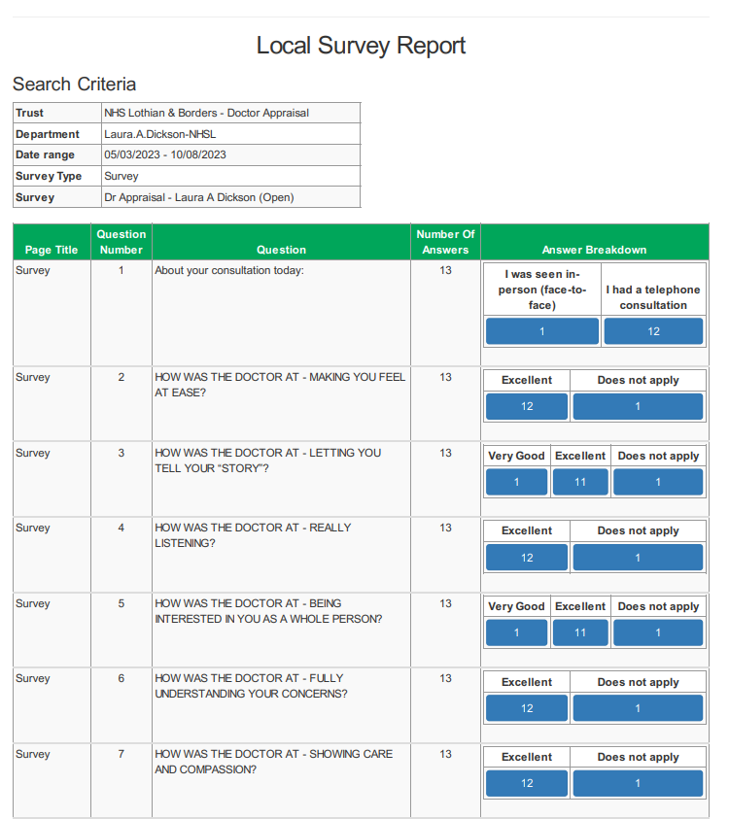
The “Lothian PSQ”
PDF Output for submission

Slide 14
The “Lothian PSQ”
Summary
A modern way to patient feedback
Free to all doctors in NHS Lothian
Offers all modalities (SMS, QR, paper)
No admin burden, can be run from mobile/laptop/desktop
Flexible; complete Clinician autonomy (probity always applies)
Enhances “Green practice”
Enhanced Accessibility: Speech, Reading, and Translation tools. (consultation with Head of equality/NHSL).

Slide 15
The “Lothian PSQ”
To request an account:
loth.psq@nhslothian.scot.nhs.uk
To learn more, click below to view:
Promotional Video
Instructional Video
Any questions?
Mimi.Cogliano@nhslothian.scot.nhs.uk
Paul.Schofield@nhslothian.scot.nhs.uk

