Slide 1
Scottish Medical Appraisers Conference
2024/2025
Summary of an Appraisal: Form 4
Dr Grecy Bell
NHS Dumfries & Galloway
Appraisal Lead (Primary Care) & Deputy Medical Director

Slide 2
Aim of today’s workshop
To promote reflection and encourage peer calibration of sampled Form 4s in small groups
Image 3947909 from pixabay.com

Slide 3
Question
When reading your own Form 4, what do you value the most?

Slide 5
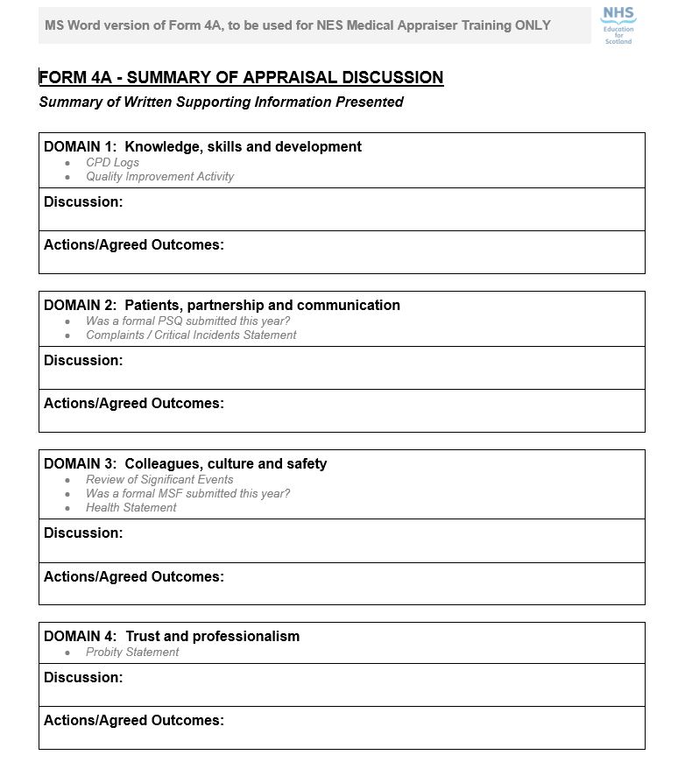
Form 4 is…
Summary of the appraisal discussion
Proof of appraisal
Should be accurate, comprehensive, and clear.

Slide 6
Form 4 GMP Domains
Pre January 2025
Post January 2025
Knowledge, skills and performance
Domain 1
Knowledge, skill and development
CPD
Safety and quality
Domain 2
Patients, partnership & communication
Health
Significant Event
QIA
Communication, partnership & teamwork
Domain 3
Colleagues, culture and safety
Complaints
PSQ
MSF
Maintaining trust
Domain 4
Trust and professionalism
Probity

Slide 7
Form 4 GMP Domains
Pre January 2025
Post January 2025
Knowledge, skills and performance
Domain 1
Knowledge, skill and development
CPD
QIA
Safety and quality
Domain 2
Patients, partnership & communication
PSQ
Complaints
Communication, partnership & teamwork
Domain 3
Colleagues, culture and safety
MSF
Health
Significant Event
Maintaining trust
Domain 4
Trust and professionalism
Probity

Slide 8
Appraisal is designed to…
support the doctor to consider all aspects of their work,
to reflect on their achievements, performance and learning for the past year, and
to think ahead for the next year.

Slide 9
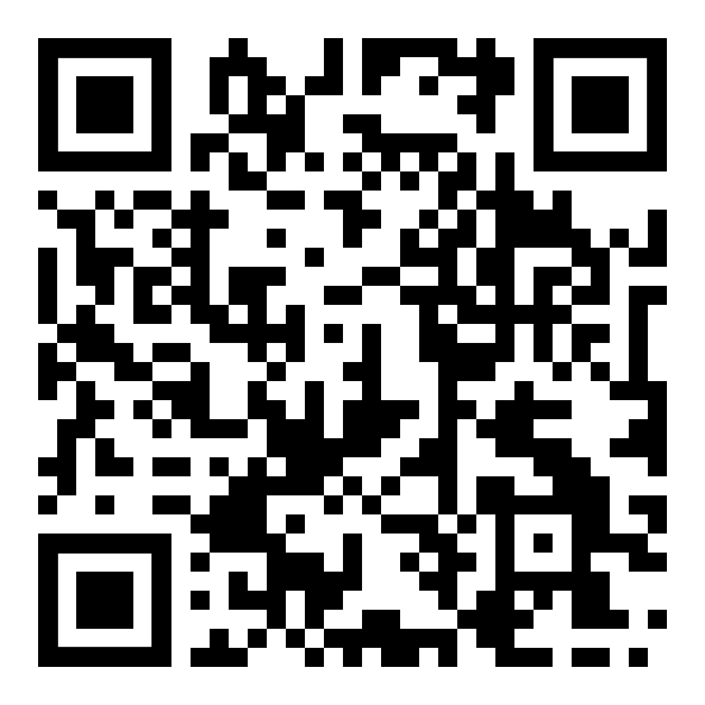
Breakout 1 instructions (20 mins)
https://www.appraisal.nes.scot.nhs.uk/s/confinfo/form4/
20 mins
Domains 1 and 2
Discuss questions…
Notes:
Go to next slide for the questions

Slide 10
Breakout 1 instructions (20 mins)
Domain 1:
What additional information do you add? (work the doctor does? additional roles?)
What about learning? (reflections on the learning? Type of learning?)
What comments do you usually make with regards to PDP?
How do you summarise QIA activity?
Do you use the actions/Agreed outcomes box?
Domain 2:
What do you normally highlight/ Record from PSQ? anything particularly good or areas to improve?
For complaints or critical incidents what do you normally include when writing the form 4?

Slide 11
Breakout 2 instructions (20 mins)
Domain 3:
What aspects of your conversation do you record on this area?
Do you add detail on the actions/Agreed outcomes?
If MSF was submitted, what areas do you highlight?
What comments do you normally write around health?
Domain 4:
What aspects of the discussion do you record in here?
Do you mention GMC good medical practice?
Do you record if the doctor is registered with a GP?

Slide 13
Top Tips
Timely completion
Third person, active voice
Positive language
The Form 4 should record all the key areas discussed at the appraisal
Image 148815 from pixabay.com

